Slide 1


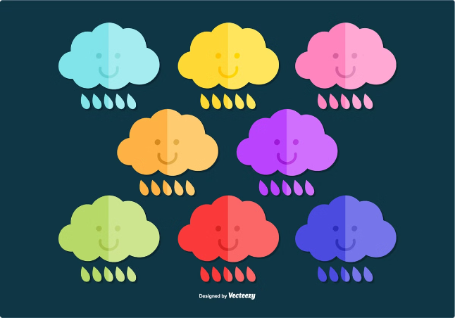
Rainfall Prediction Using Machine Learning
Rainfall prediction is essential for managing water resources, mitigating flood risks, and ensuring food security. Machine learning, with its ability to learn from data, has emerged as a powerful tool for enhancing rainfall prediction accuracy.

Slide 2

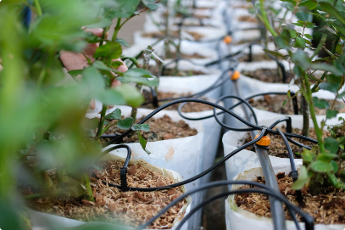
Importance of Rainfall Prediction
1
Water Resource Management
2
Flood Risk Mitigation
Rainfall prediction helps optimize water resource allocation, ensuring sufficient supply for agriculture, industry, and domestic use.
Accurate rainfall forecasts enable early warning systems, allowing authorities to prepare for potential floods and minimize damage.
3
Agricultural Planning
4
Climate Change Adaptation
Farmers rely on rainfall predictions to plan planting seasons, irrigation schedules, and crop selection, maximizing yields and minimizing losses.
Understanding rainfall patterns and their variations is crucial for developing strategies to adapt to climate change and its impacts.

Slide 3
Machine Learning Techniques
Linear Regression
Support Vector Machines (SVM)
Artificial Neural Networks (ANN)
A statistical method that establishes a linear relationship between rainfall and other factors, like temperature and humidity.
A supervised learning technique that separates data points into distinct classes, predicting rainfall occurrence or intensity.
Complex models inspired by the human brain, capable of learning nonlinear relationships and patterns in rainfall data.

Slide 4


Data Collection and Preprocessing
1
Data Acquisition
Gathering rainfall data from various sources, including weather stations, satellites, and historical records.
2
Data Cleaning
Removing errors, inconsistencies, and missing values from the dataset, ensuring data quality and reliability.
3
Data Transformation
Converting data into a suitable format for machine learning models, potentially scaling or normalizing values.

Slide 5

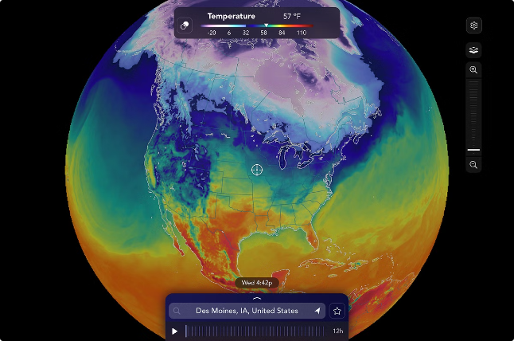
Feature Engineering and Selection
Feature Engineering
Creating new features from existing data, such as calculating wind speed or relative humidity.
Feature Selection
Identifying the most relevant features that contribute significantly to rainfall prediction accuracy.

Slide 6


Model Selection and Training
Model Choice
Model Training
Selecting the most appropriate machine learning algorithm based on data characteristics and desired accuracy.
Using a training dataset to adjust the model's parameters, enabling it to learn patterns and relationships.
Hyperparameter Tuning
Optimizing the model's parameters to improve its performance on unseen data, ensuring optimal prediction capabilities.

Slide 7






Evaluation Metrics and Model Performance
Accuracy
Measures the percentage of correctly predicted rainfall events.
Precision
Indicates the proportion of correctly predicted rainfall events among all predicted events.
Recall
Represents the percentage of actual rainfall events that were correctly predicted.
F1 Score
Combines precision and recall into a single metric, providing a balanced evaluation of model performance.

Slide 8
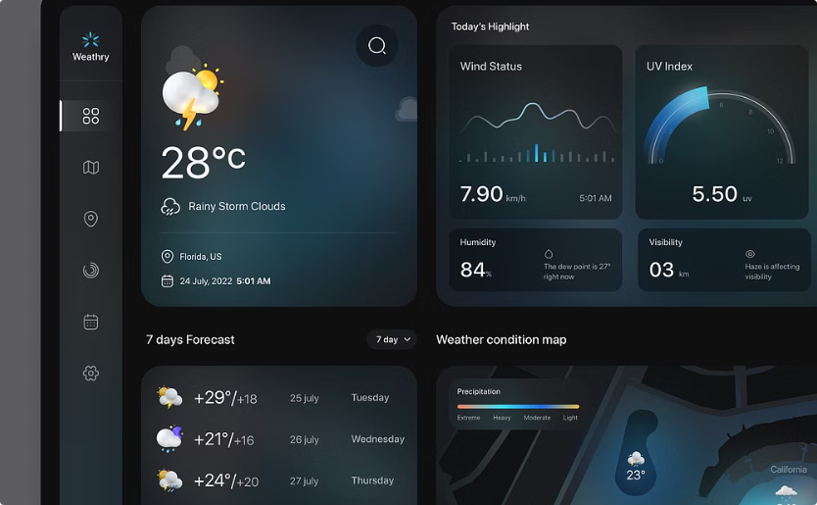

Deployment and Monitoring
Deployment
Monitoring
Making the trained model accessible to users through web applications, mobile apps, or APIs.
Continuously evaluating the model's performance, identifying any potential issues, and retraining or updating the model as needed.

Slide 9

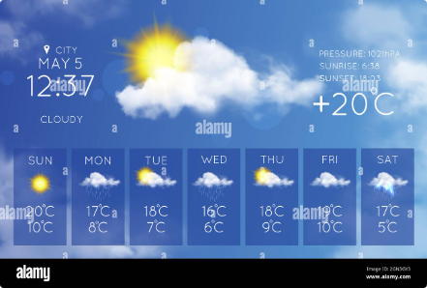




Challenges and Limitations
Data Availability
Weather Complexity
Model Bias
Climate Change
Limited access to comprehensive and high-quality rainfall data can hinder model accuracy and generalization.
Atmospheric processes are complex and influenced by multiple factors, making accurate rainfall prediction challenging.
Machine learning models can exhibit bias, potentially leading to inaccurate predictions for specific locations or time periods.
Shifts in rainfall patterns due to climate change can impact model performance, requiring adjustments and adaptation.

Slide 10


Conclusion and Future Directions
Machine learning offers significant potential for improving rainfall prediction accuracy. Future research should focus on developing more advanced models, integrating diverse data sources, and addressing the challenges posed by climate change.

